Slide 1

Report on Performance e-Tool
Advancing Hospice
Palliative Care Capacity Planning
in the
South West LHIN
2017 Capacity Refresh

Slide 2
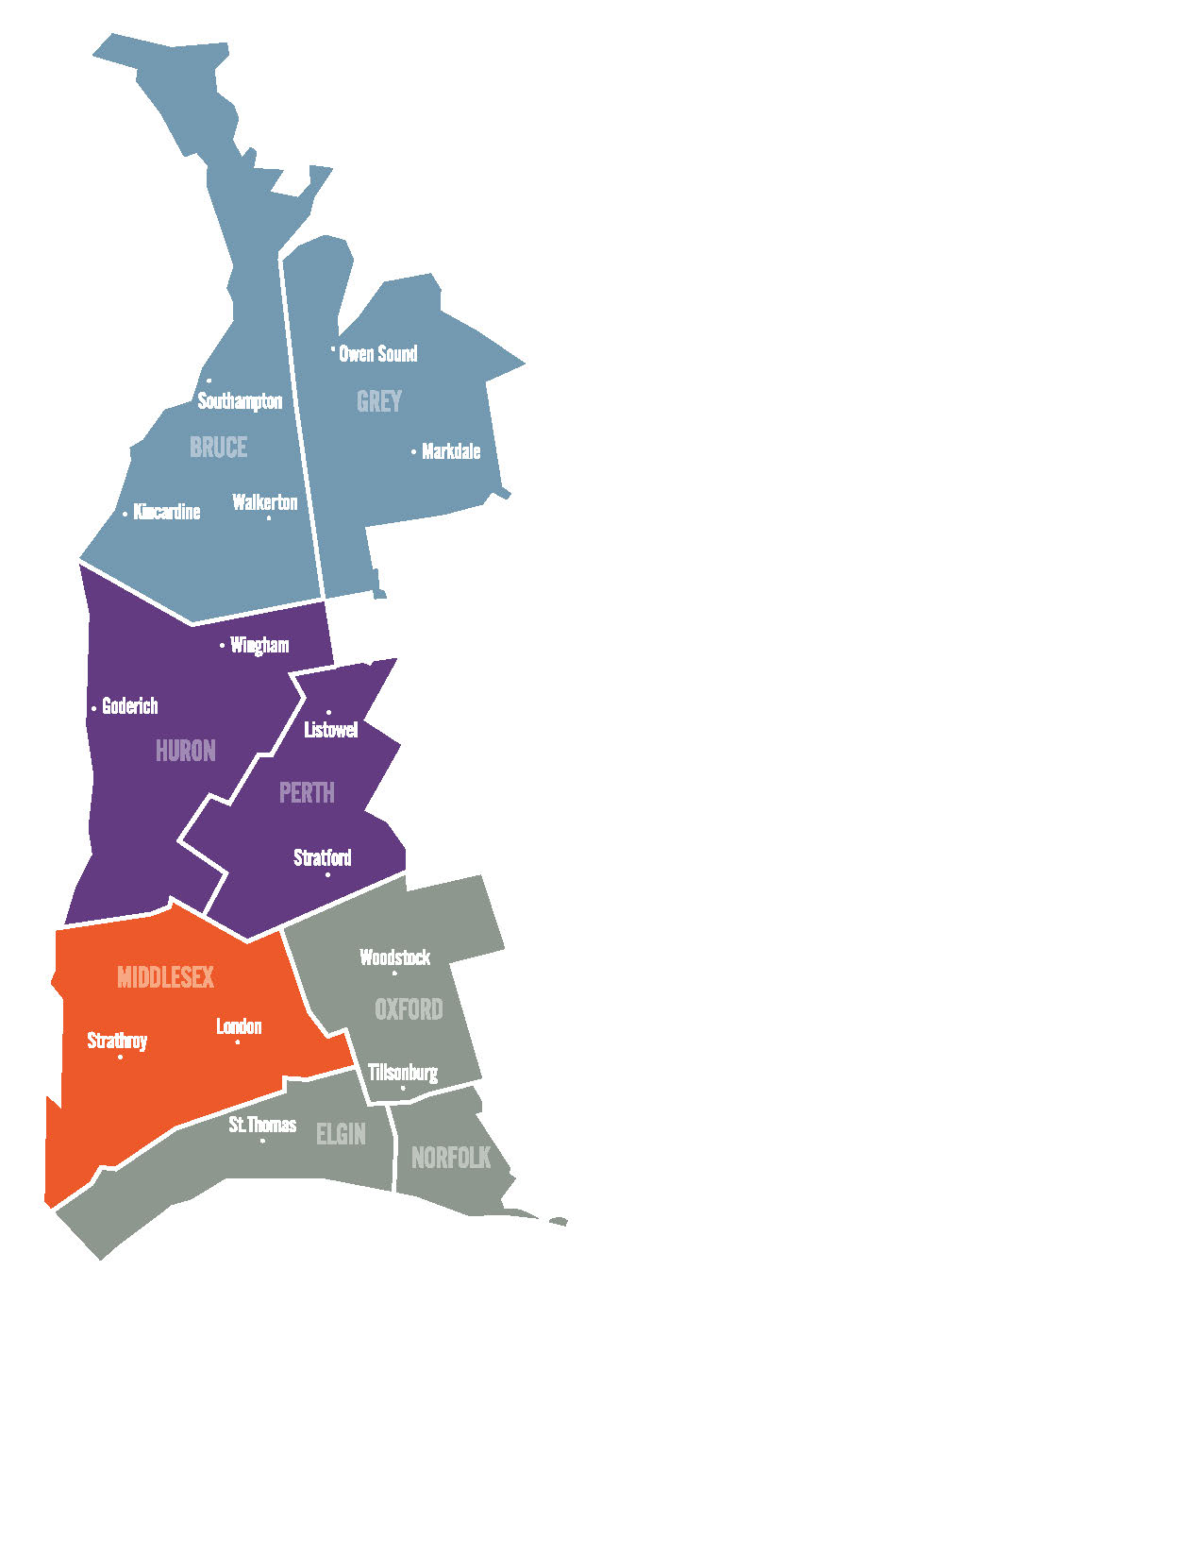
Presentation Overview
Recap of Capacity Planning Objectives, Recommendations and Progress to Date
Refresh Methodology
2016/17 Deaths by Sector
2016/17 Hospice Capacity Benchmarks
Hanover

Slide 3
Hospice Palliative Care Capacity Planning
Review

Slide 4
Hospice Capacity Planning
In January 2015, HPC Leadership Committee began a journey to understand current state resources for HPC in the SW LHIN, and determine the need for additional resources within the local health care system.
July 2015: Hospice Palliative Care Capacity Report
November 2016: Advancing Hospice Palliative Care Capacity Planning
Five Key Recommendations for Planning:
Develop new residential hospice capacity and review existing capacity annually.
Spread hospice palliative care outreach services.
Incorporate strategies for early identification.
Enhance palliative education in home, community and long-term care settings.
Reduce the overall percentage of deaths that occur in hospital.

Slide 5
Progress on Key Recommendations
Recommendation 1: Develop new residential hospice capacity
Two new Residential Hospice beds were added in Grey Bruce in FY17/18.
Two additional beds (satellite site) will be added in Grey Bruce in FY 18/19.
Ten beds are currently being established in Huron Perth.
Average occupancy in all Residential Hospices currently exceeds 85%.
Source: Residential Hospice Monthly Reporting. Submitted to the South West LHIN from each Hospice.

Slide 6
Progress on Key Recommendations
Recommendation 2: Spread hospice palliative care outreach services
New Secondary Level Outreach Consultation Team operational in Huron Perth.
Spread of Secondary Outreach in Grey Bruce, Oxford and Elgin.
93% of patients supported by Outreach Teams are dying in their place of choice.

Slide 7
Progress on Key Recommendations
Recommendation 3: Incorporate strategies for early identification
Asking the Question, Use of Speak Up Strategy
Spread of SPICT Tool and Gold Standards Framework.
INTEGRATE Project. London-Middlesex
Early Identification Model Roll Out - Sub-Regions

Slide 8
Progress on Key Recommendations
Recommendation 4: Enhance palliative education in home, community
and long-term care settings
Survey completed across the South West gaining insight from HPC service providers.
Recommendations developed based on survey results.
Financial Support acquired through one time funding.
Palliative Pain and Symptom Management Consultation Team will increase palliative
care education programs in home and community e.g. CAPCE /Fundamentals

Slide 9
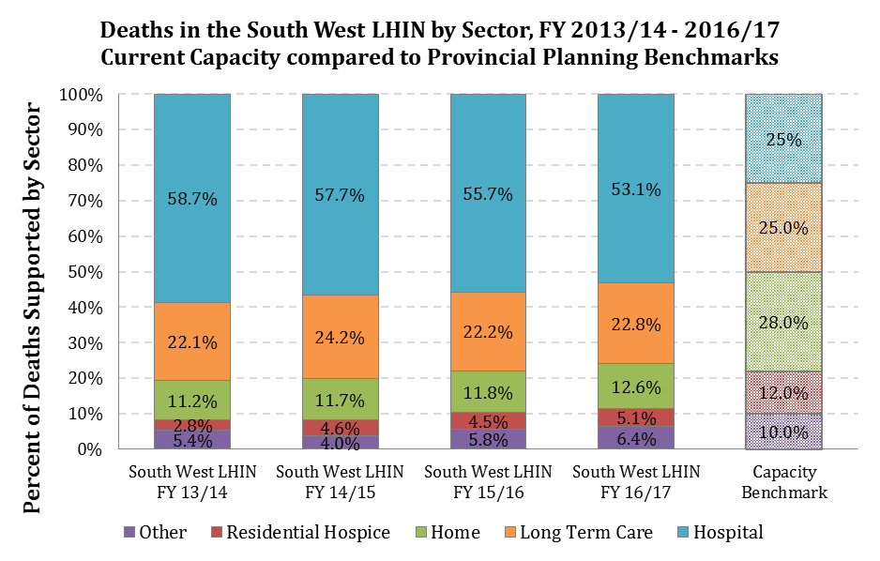
Progress on Key Recommendations
Recommendations 5: Reduce the overall percentage of deaths that
occur in hospital
Since FY 2013/14, the South West LHIN has seen a 10% reduction in deaths occurring in hospital settings (6% absolute change).

Slide 10
Hospice Palliative Care Capacity Report – Methodology
Used a Population-based approach to look at the total number and proportion of resident deaths that occurred in the South West LHIN and the sub-region geographies, supported by each health care sector between fiscal 2013/2014 and fiscal 2016/2017.
Total deaths by sector are described and compared over time to the Provincial Capacity Benchmark Recommendations
‘Actual’
Current State
Vital Statistics;
Administrative
Data
Gap Analysis
Desired Future State
(Benchmarks)
ACTION Plan / Recommendations

Slide 11
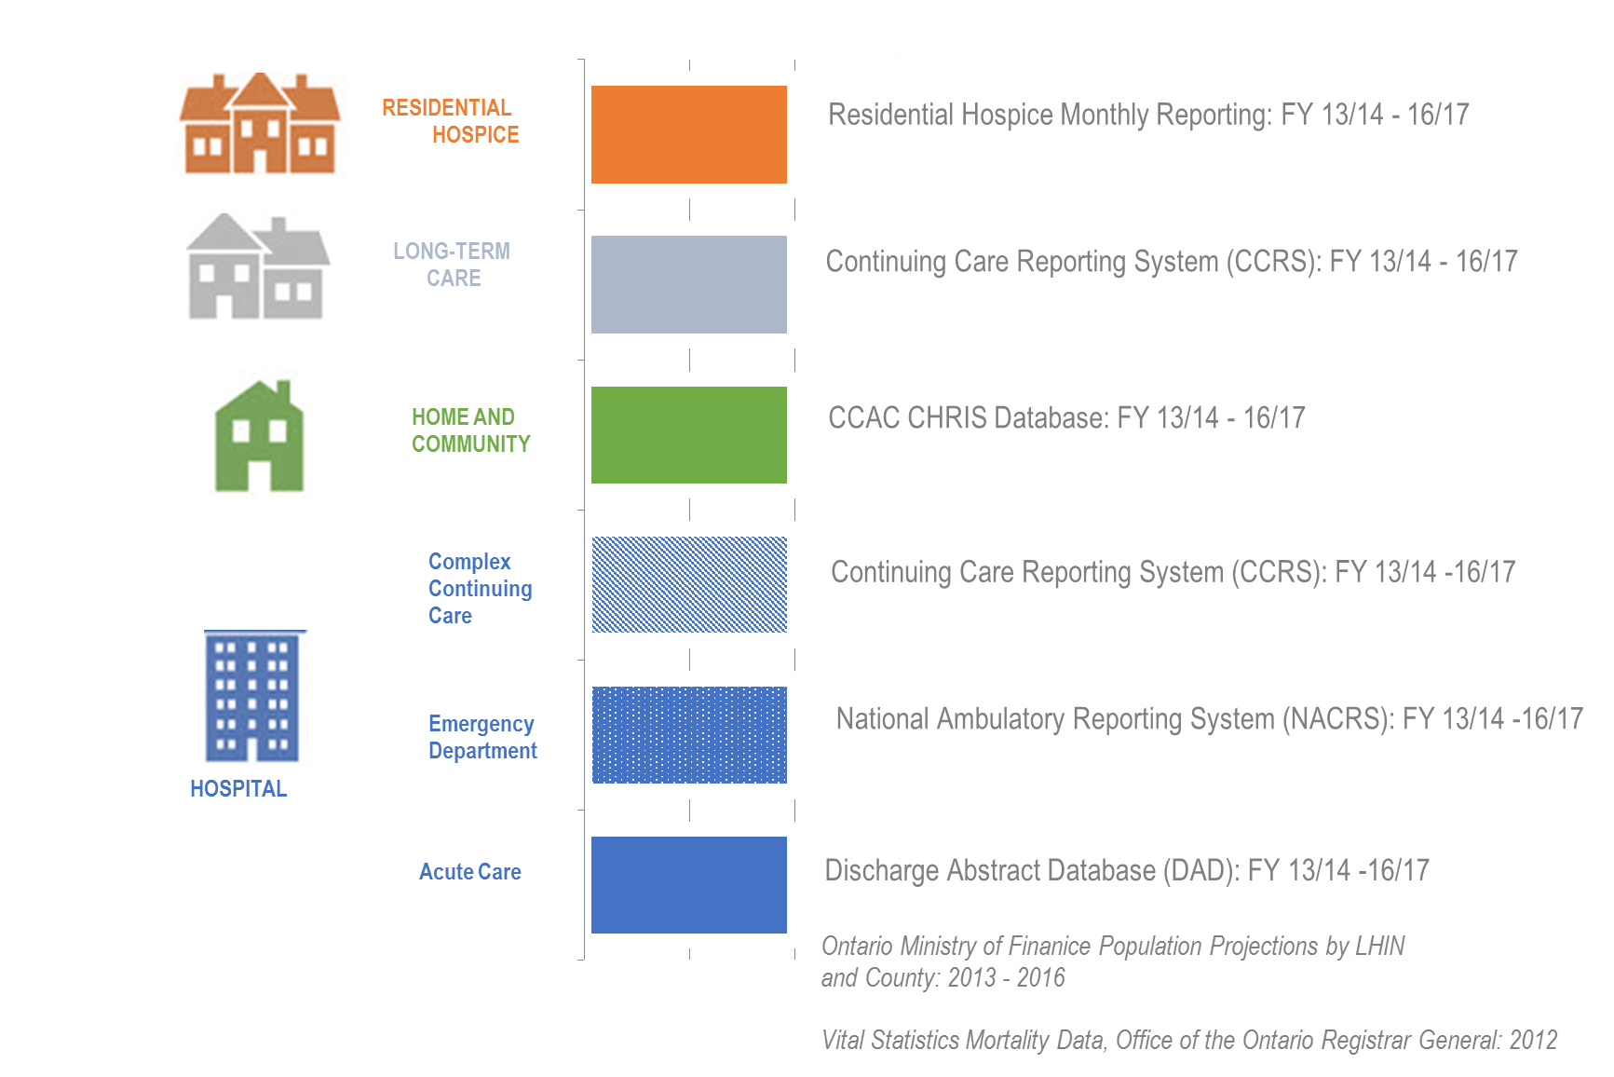
Description of Data Sources by Sector

Slide 12
2017 HPC Capacity Refresh
Deaths by Health Care Sector

Slide 13

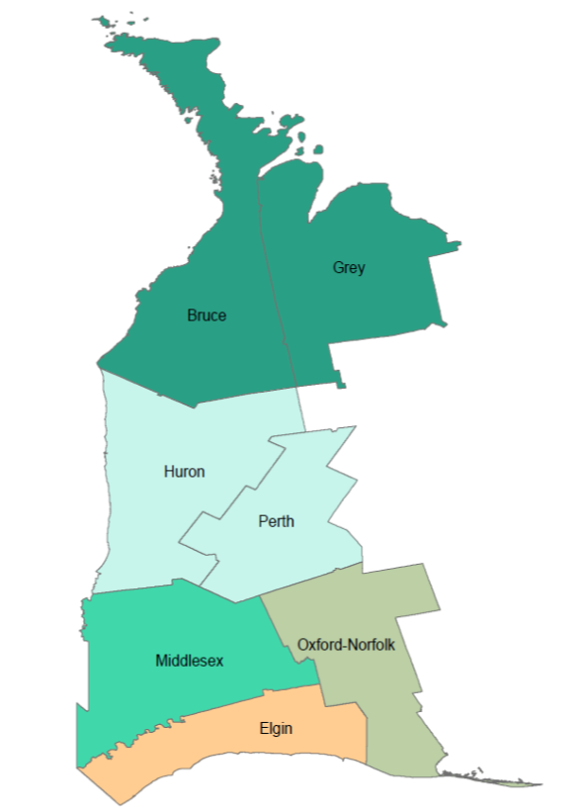
Residential Hospice
Since FY 2013/14, the South West LHIN has seen an 82% increase in the number of
deaths supported in Residential Hospice.
In FY 2016/17, the South West LHIN supported 4.4 deaths in Residential Hospice per 10,000 population compared to 3.9 deaths per 10,000 population in FY 2015/16.
Residential Hospice of Grey Bruce
8 Bed Hospice
St. Joseph’s Hospice
10 Bed Hospice
Sakura House
10 Bed Hospice
Source: Residential Hospice Monthly Reporting. Submitted to the South West LHIN from each Hospice.

Slide 14
Residential Hospice
In FY 2016/17, the numbers of deaths supported in RH, adjusted for population size,
were highest for residents from Oxford and Grey Bruce, and lowest for
residents from Huron Perth and Elgin.
FY 2016/17
Patient County | Number of Deaths Supported In Residential Hospice |  |  |  | 2016 Population Estimate | RH Deaths per 10,000 Residents
 | Sakura House | St. Joseph's Hospice | Residential Hospice of Grey Bruce | Total Number of Deaths
Grey | 0 | 0 | 69 | 69 | 93,830 | 7.4
Bruce | 0 | 0 | 37 | 37 | 68,147 | 5.4
Huron | <5 | <5 | 0 | 2-8 | 59,297 | 0.3-3.0
Perth | 14 | 0 | 0 | 14 | 76,796 | 1.8
Oxford Norfolk | 137 | 0 | 0 | 137 | 123,671 | 11.1
London Middlesex | <5 | 143 | 0 | 144-147 | 455,526 | 3.1-3.2
Elgin | 9 | <5 | 0 | 10-13 | 88,978 | 1.1-1.5
Out of LHIN | <5 | <5 | <5 | 3-12
Total SW LHIN | 163-172 | 146-155 | 107-110 | 416 | 981,045 | 3.9-4.1
Source: Residential Hospice Monthly Reporting. Submitted to the South West LHIN from each Hospice; Ontario Population Estimates, 2016 Canada Census by County. Note: South West LHIN population projects the number of residents in the LHIN’s Geography, which excludes small pockets of Grey and Norfolk Counties. County populations will not sum to the LHIN Population.

Slide 15
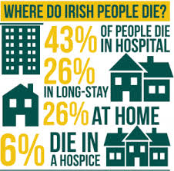
Home and Community
Number of Deaths Supported in the Community (at Home), by Patient County of Residence. South West LHIN FY 13/15 - 16/17.
In FY 2016/17 LHIN Home Care services
supported 1,064 deaths at home.
Of the total deaths in FY 2016/17,
716 were Complex Palliative clients (67.3%).
Since FY 2013/14, the South West CCAC
has supported an 19% increase in total
deaths, and a 27% increase in Complex
Palliative deaths at home.
Source: South West LHIN; CHRIS Database

Slide 16
Home and Community
In FY 2016/17, the numbers of Complex Palliative deaths supported through LHIN Home
Care, adjusted for population size, were highest for residents from Huron Perth and
Elgin and lowest for Oxford/Norfolk residents.
FY 2016/17
Patient County | Complex Palliative Clients | Complex Palliative Client Died at Home | Total CCAC Clients Died at Home | % of CCAC Deaths at Home that are Complex Palliative | 2016 Population Estimate | Total CCAC Deaths per 10,000 Population | CCAC Complex Palliative Deaths at Home per 10,000 Population
Grey | 313 | 62 | 112 | 55.4% | 93,830 | 11.9 | 6.6
Bruce | 242 | 50 | 85 | 58.8% | 68,147 | 12.5 | 7.3
Huron | 176 | 50 | 79 | 63.3% | 59,297 | 13.3 | 8.4
Perth | 238 | 60 | 90 | 66.7% | 76,796 | 11.7 | 7.8
Oxford Norfolk | 422 | 47 | 80 | 58.8% | 123,671 | 6.5 | 6.5
London Middlesex | 1,315 | 353 | 491 | 71.9% | 455,526 | 10.1 | 7.7
Elgin | 305 | 85 | 111 | 76.6% | 88,978 | 12.5 | 9.6
Out of LHIN | 37 | 9 | 16 | 56.2%
Total SW LHIN | 3,048 | 716 | 1,064 | 67.3% | 981,045 | 10.8 | 7.3
Source: South West LHIN, CHRIS Database; Ontario Population Estimates, 2016 Canada Census by County. Note: Counts reflect point-in-time data, accurate at the date of extraction. Death counts may change over time due to active updates and corrections in patient records. South West LHIN population projects the number of residents in the LHIN’s Geography, which excludes small pockets of Grey and Norfolk Counties. County populations will not sum to the LHIN Population.

Slide 17

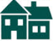
Long-Term Care
In FY 2016/17 LTC homes supported 1,924 resident deaths in the community.
LTC homes have supported an 8.0% increase in total resident deaths since FY 2013/14.
Number of Deaths Supported in Long-Term Care, by County of Home. South West LHIN, FY 13/15 - 16/17.
11 LTC Homes
786 Beds
8 LTC Homes
539 Beds
11 LTC Homes
647 Beds
8 LTC Homes
579 Beds
23 LTC Homes
3,332 Beds
9 LTC Homes
776 Beds
8 LTC Homes
683 Beds
Source: CCRS Database, Residential Sector; obtained through IntelliHealth, MOHLTC.

Slide 18
Long-Term Care
In FY 2016/17, adjusted for population size, resident deaths in LTC Homes were
highest in Huron and lowest in Oxford/Norfolk.
FY 2016/17
Patient County | LTC Home Deaths, FY 2016/17 | 2016 Population Estimate | Total LTC Deaths per 10,000 Population, FY 2016/17 | Number of LTC Beds per 10,000 Population
Grey | 239 | 93,830 | 25.5 | 82.3
Bruce | 146 | 68,147 | 21.4 | 79.1
Huron | 159 | 59,297 | 26.8 | 100.1
Perth | 153 | 76,796 | 19.9 | 84.2
Oxford Norfolk | 208 | 123,671 | 16.8 | 61.9
London Middlesex | 825 | 455,526 | 18.1 | 71.0
Elgin | 155 | 88,978 | 17.4 | 75.0
Out of LHIN/Unknown | 39
Total SW LHIN | 1,924 | 981,045 | 19.6 | 74.8
Source: CCRS Database, Residential Sector; Ontario Population Estimates, 2016 Canada Census by County. Note: South West LHIN population projects the number of residents in the LHIN’s Geography, which excludes small pockets of Grey and Norfolk Counties. County populations will not sum to the LHIN Population.

Slide 19
Hospital Sector
In FY 2016/17, the total number of deaths occurring in hospital declined for the first time
since FY 2013/14, with fewer deaths observed in Acute and Complex Continuing Care.
80.6% of deaths were reported in Acute Care, 10.4% were reported in the Emergency
Department, 8.4% in Complex Continuing Care, 0.3% in Inpatient Psychiatric/Mental Health
and 0.3% in Inpatient Rehabilitation.
Number of Deaths Supported in Occurring in Hospital, by Sector. South West LHIN, FY 13/15 - 16/17.
Source: DAD, NACRS, CCRS, OMHRS, NRS. Retrieved through IntelliHealth, MOHLTC.

Slide 20
Hospital Sector
In FY 2016/17, London Middlesex had the lowest rate of total hospital deaths per
10,000 population while Bruce County had the highest rate of hospital deaths.
FY 2016/17
Patient County | Acute Care Deaths | Emergency Department Deaths | Complex Continuing Care Deaths | Inpatient Rehabilitation Deaths | Inpatient Mental Health Deaths | Total Hospital Deaths | 2016 Population Estimate | Hospital Deaths per 10,000 Population
Grey | 362 | 60 | <5 | 0 | <5 | 425 | 93,830 | 45.3
Bruce | 291 | 44 | 6 | 0 | <5 | 341-345 | 68,147 | 50.0-50.6
Huron | 204 | 37 | 45 | <5 | 0 | 287-290 | 59,297 | 48.4-48.9
Perth | 213 | 42 | 72 | 0 | 0 | 327 | 76,796 | 42.6
Oxford Norfolk | 448 | 58 | 27 | 0 | 0 | 533 | 123,671 | 43.1
London Middlesex | 1,507 | 157 | 156 | 6 | 7 | 1,833 | 455,526 | 40.2
Elgin | 324 | 37 | 53 | <5 | <5 | 420 | 88,978 | 47.2
Out of LHIN | 271 | 33 | 16 | 0 | 0 | 320
Total SW LHIN | 3,620 | 467 | 376-379 | 14 | 12 | 4,706 | 981,045 | 48.0
Source: DAD, NACRS, CCRS, OMHRS, NRS. Ontario Population Estimates, 2016 Canada Census by County. Note: South West LHIN population projects the number of residents in the LHIN’s Geography, which excludes small pockets of Grey and Norfolk Counties. County populations will not sum to the LHIN Population.

Slide 21
Cross-Sector Summary – Mortality per 10,000 Population
The hospital sector continues to support the largest number of resident deaths.
LTC homes support the largest number of resident deaths in home and community settings.
Resident County | Number of Resident Deaths per 10,000 Population
 | Residential Hospice | Home Care Client Deaths | Home Care -Complex Palliative Deaths | LTC Home Deaths | Total Hospital Deaths
Grey | 7.4 | 11.9 | 6.6 | 25.5 | 45.3
Bruce | 5.4 | 12.5 | 7.3 | 21.4 | 50.0-50.6
Huron | 0.3-3.0 | 13.3 | 8.4 | 26.8 | 48.4-48.9
Perth | 1.8 | 11.7 | 7.8 | 19.9 | 42.6
Oxford Norfolk | 11.1 | 6.5 | 6.5 | 16.8 | 43.1
London Middlesex | 3.1-3.2 | 10.1 | 7.7 | 18.1 | 40.2
Elgin | 1.1-1.5 | 12.5 | 9.6 | 17.4 | 47.2
Total SW LHIN | 3.9 - 4.1 | 10.8 | 7.3 | 19.6 | 48.0

Slide 22
2016 HPC Benchmarks
Deaths by Health Care Sector

Slide 23
Determining the Estimated Number of Deaths in a Geography
Determine age-specific population estimates for a given geography.
Determine age-specific death rates for a given geography.
Multiply age-specific population estimate by age-specific death rate to estimate # deaths.
Patient County | 2016 Population Estimates |  |  | 2012 Age Specific Death Rates per 10,000 Population |  |  | Projected Deaths for 2016
 | 0-64 Years | 65+ Years | Total | 0 - 64 Years | 65+ Years | Total | 0 - 64 Years | 65+ Years | Total
Grey | 71,200 | 22,630 | 93,830 | 21.3 | 412.9 | 105.2 | 152 | 934 | 1,086
Bruce | 52,072 | 16,075 | 68,147 | 21.9 | 339.4 | 86.7 | 114 | 546 | 659
Huron | 45,842 | 13,455 | 59,297 | 20.4 | 378.9 | 92.9 | 94 | 510 | 603
Perth | 62,476 | 14,320 | 76,796 | 17.3 | 440.2 | 86.9 | 108 | 630 | 738
Oxford Norfolk | 100,110 | 23,561 | 123,671 | 20.9 | 371.0 | 80.5 | 209 | 874 | 1,084
London Middlesex | 378,781 | 76,745 | 455,526 | 17.8 | 384.6 | 72.5 | 674 | 2,952 | 3,626
Elgin | 72,838 | 16,140 | 88,978 | 21.2 | 419.8 | 84.3 | 155 | 677 | 832
South West LHIN | 806,748 | 174,297 | 981,045 | 19.3 | 393.6 | 81.8 | 1,558 | 6,860 | 8,418
Divide the actual number of deaths that occurred in each sector by the total projected deaths in a given geography to estimate the percentage of resident deaths supported by sector.

Slide 24
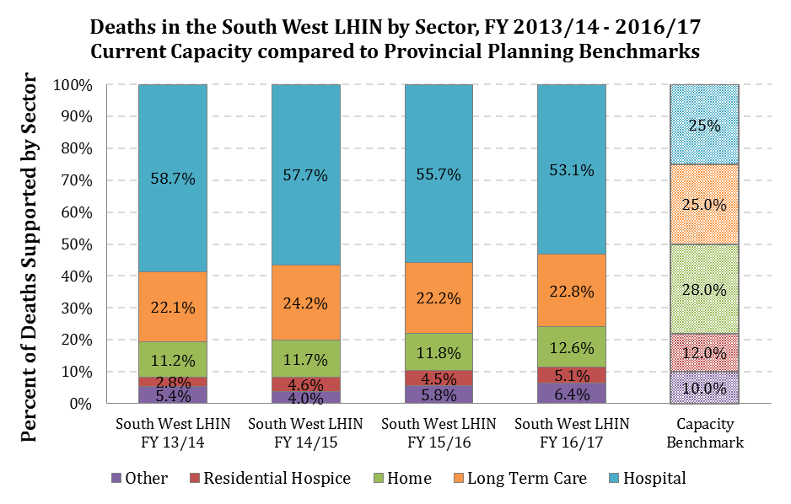
Current vs. Future State
Palliative Services and Resources are increasing in the South West LHIN and effectively shifting deaths from hospital to community settings, but still not at a rate necessary to
offset population growth and increased demand for community palliation.

Slide 25
Current vs. Future State by LHIN Sub-Region
*Proportions are sensitive to estimated Population growth and mortality trends within each sub-region

Slide 26
Residential Hospice Planning: Population-Based Bed Ratios
 | Population-Based Benchmarked Bed Ratio Corridors
Resident County | Current South West LHIN RH Bed Resources | 2016 Population Estimates | Current South West LHIN RH Beds per 100,000 Residents | Recommended Minimum RH Beds per 100,000 Residents (EOL Report) | Recommended Maximum RH Beds per 100,000 Residents (EOL Report) | RH Bed Resources to meet Minimum Bed Capacity | RH Bed Resources to meet Maximum Bed Capacity | Additional RH Beds required (Projected - Current)
Grey | 8 | 93,830 | 8.5 | 5.1 | 6.8 | 5 | 7 | 0
Bruce | 0 | 68,147 | 0.0 | 5.1 | 6.8 | 4 | 5 | 5
Huron | 0 | 59,297 | 0.0 | 5.1 | 6.8 | 3 | 4 | 4
Perth | 0 | 76,796 | 0.0 | 5.1 | 6.8 | 4 | 6 | 5
Oxford Norfolk | 10 | 123,671 | 8.1 | 5.1 | 6.8 | 6 | 9 | 0
Middlesex | 10 | 455,526 | 2.2 | 5.1 | 6.8 | 24 | 31 | 14-21
Elgin | 0 | 88,978 | 0.0 | 5.1 | 6.8 | 5 | 6 | 6
South West LHIN Total | 28 | 981,045 | 2.9 | 5.1 | 6.8 | 50 | 67 | 22-39

Slide 27
Residential Hospice Planning: 12% Benchmark for RH
Resident County | Current South West LHIN RH Bed Resources | Current South West LHIN RH Beds per 100,000 Residents | 2016/17 Deaths in RH | Projected 2016 Deaths | Projected Supported Deaths in RH to meet 12% Benchmark | Additional Deaths Required in RH to meet 12% Benchmark | RH Bed Resources Benchmark (Based on 3wk LOS) | RH Bed Resources to meet Benchmark (Based on 4wk LOS) | Additional RH Beds required
Grey | 8 | 8.5 | 69 | 1,086 | 130 | 54 | 8 | 10 | 0
Bruce | 0 | 0.0 | 37 | 659 | 79 | 53 | 5 | 7 | 5
Huron | 0 | 0.0 | 2-8 | 603 | 72 | 65 | 4 | 6 | 4
Perth | 0 | 0.0 | 14 | 738 | 89 | 70 | 5 | 7 | 6
Oxford Norfolk | 10 | 8.1 | 137 | 1,084 | 130 | 0 | 8 | 10 | 0
Middlesex | 10 | 2.2 | 144-147 | 3,626 | 435 | 326 | 26 | 34 | 16-24
Elgin | 0 | 0.0 | 10-13 | 832 | 100 | 92 | 6 | 8 | 7
South West LHIN Total | 28 | 2.9 | 416 | 8,418 | 1,010 | 631 | 59 | 78 | 31-50
To achieve the Provincial Benchmark supporting 12% of population deaths in Residential Hospice would require a total of 59-78* beds in the South West LHIN, or 31 to 50 additional beds from those operating as of December 1, 2017.
*Projections assume 100% bed occupancy, a 3 week (minimum) to 4 week (maximum)
average length of stay, and zero population growth.

Slide 28
Residential Hospice Planning: 2020-2022 Estimated Impact
If we expand our current RH Bed Capacity (28 to 40 Beds) in FY 18/19, and fill those beds to 100% occupancy in FY 19/20, the SW LHIN could serve a maximum of 692 residents/year at an average 3 week length of stay.
With the LHIN’s projected population growth, the HIGHEST proportion of deaths we should reasonably expect to support in RH with planned expansion in the next two years is 7.0%.
To meet the 12% benchmark for residential hospice by 2022 given anticipated population growth, we would need to support 1,240 residents in RH. This would require expansion and investment into London Middlesex.
These estimates assume mortality rates remain constant and do not increase.

Slide 29
Next Steps for Hospice Capacity Planning in the South West
In FY 2018/19, the South West LHIN will re-align Capacity Planning methods against those described in OPCN’s 3-Year Action Plan.
Palliative Care performance metrics will be re-aligned with OPCN, the MOHLTC, and the South West LHIN’s Performance Management Strategies.

Slide 30
For more information please email:
Heather.white@lhins.on.ca

